Slide 1
Project Mid Presentation
“Fraud Transaction Detection System”
Supervised By
Md. Eusha Kadir
Lecturer, IIT, NSTU
Presented by
Md Mynuddin
ID: ASH1825007M
IIT, NSTU
‹#›

Slide 2

Introduction
Problem : Fraud Transaction Detection
Research Objective : Rule based feature extraction and handle imbalance dataset.
Dataset : Spanish Bank Synthetic Data

Slide 3
Related Works
“Credit Card Fraud Detection using Machine Learning and Data Science”
by Aditya Saini, Swarna Deep Sarkar, Shadab Ahmed, S P Maniraj,
IJERT, Accepted: 09, September-2019
Proposed Framework : Local Outlier Factor and Isolation Forest Algorithm on the PCA transformed Credit Card Transaction data.
Comparison : No comparison with other methods.
Dataset : Credit card dataset.
Problem : only use two outlier detection algorithm, no comparison with other methods.

Slide 4
Related Works
“Fraud Detection in Mobile Payment Systems using an XGBoost‑based Framework”
by Petr Hajek,Mohammad Zoynul Abedin,Uthayasankar Sivarajah
Published on Information Systems Frontiers, Accepted: 23 September 2022
Proposed Framework : XGBOD + XGBoost Classifier with RUS
Comparison : Other outlier detection algorithm and KNN,SVM, Random Forest
Dataset : Simulated Spanish Bank Dataset
Robustness Test : Use credit card fraud dataset
Problem : They use only “Random under sampling” for handle imbalance data. So in my perspective most of the important data are lost. In our approach we will try different
data balance technique. Another one is in Outlier detection. Most of the case fraud transaction has high possibility to be outlier.They perform outlier algorithm in whole dataset. So the ratio of data imbalance will be increases than before.

Slide 5
Related Works
“A machine learning based credit card fraud detection using the GA algorithm for feature selection”
by Emmanuel Ileberi1*, Yanxia Sun1 and Zenghui Wang2
Journal of Big Data, Published: 25 February 2022
Proposal : Feature selection using Genetic algorithm. Random Forest use for fitness function,min-max scaling to normalize and use SMOTE for handle imbalanced data.
Comparison : Performance evaluation compare without feature selection and after feature selection Decision Tree (DT),Random Forest (RF), Logistic Regression (LR), Artificial Neural Network (ANN), and Naive Bayes (NB).
Dataset : Credit Card Dataset.
Problem : Some important feature may be not selected and only use smote for data balance

Slide 6
Related Works
“A Feature Extraction Method for Credit Card Fraud Detection”
by Yu Xie, Guanjun Liu, Ruihao Cao, Zhenchuan Li, Chungang Yan, and Changjun Jiang
IEEE, Published 01 August 2019
Proposal : Rule based and frequency based feature extraction.
Comparison : Performance from Raw data , Raw data + Frequency based feature extraction(F1) , Raw data + Rule based feature extraction(F2) and Raw data + F1+F2.
Dataset : A financial company dataset in china.
Problem : The dataset is not available. So i can’t accused something about it. But normally in any transaction dataset have data imbalance problem. This dataset should be also have data imbalance problem.And they are not use any methods to handle imbalance data.

Slide 7

Research Methodology

Slide 8
First Approach
Raw Data
State of the art machine learning algorithm or it can be neural network.
Feature Engineering
ML Algorithm
As it’s a classification model, here the evaluation are AUC, RUC, Precision, Recall.
Performance Evaluation

Slide 9
Second Approach
Raw Data
Feature Engineering
Handle Imbalance Data
RUS
Border-line SMOTE
SMOTE
K-Means SMOTE
Data Balance Technique
ML Algorithm
Performance Evaluation

Slide 10
Third Approach
Raw Data
Rule Based Feature Extraction
Feature Engineering
Handle Imbalance Data
RUS
Border-line SMOTE
SMOTE
K-Means SMOTE
Data Balance Technique
ML Algorithm
Performance Evaluation

Slide 11
Compare the approach
First Approach
Raw Data
Second Approach
Compare Performance Evaluation
Raw Data + Feature Extraction + Handle imbalance data
Third Approach
Get the best approach
Raw Data + Handle imbalance data

Slide 12
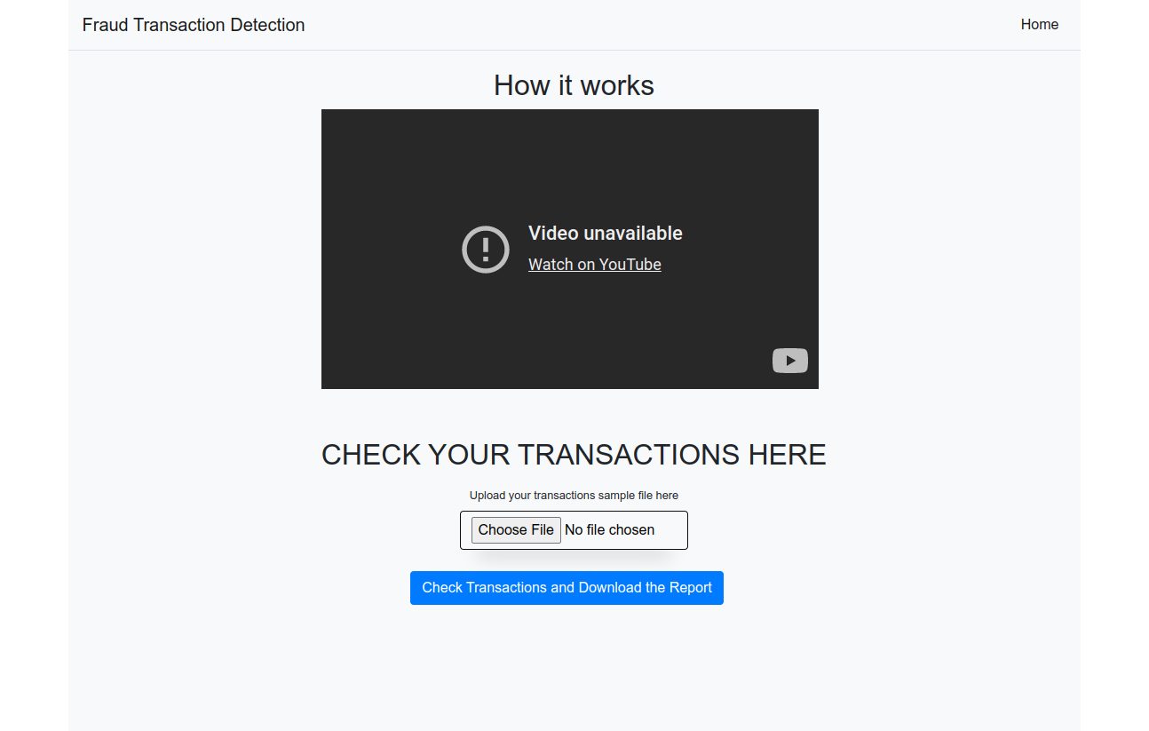
Project Progress

Slide 13
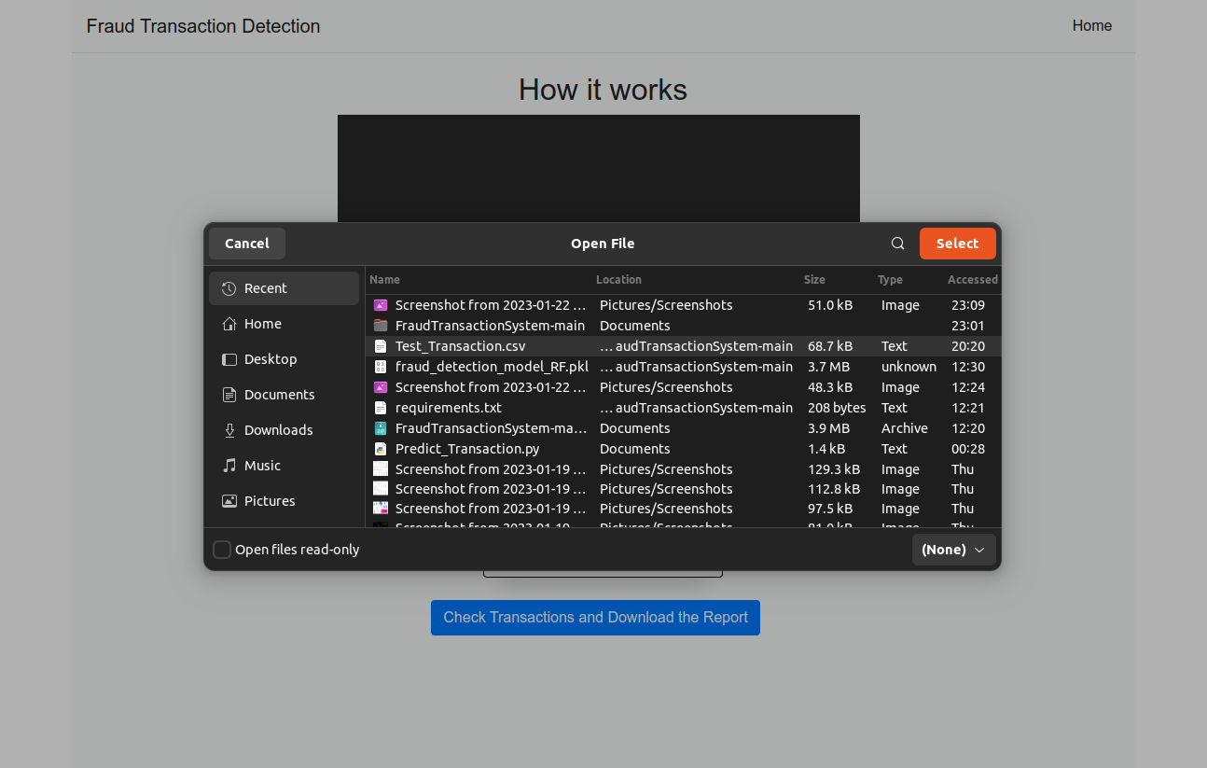
Project Progress

Slide 14

Project Progress

Slide 15
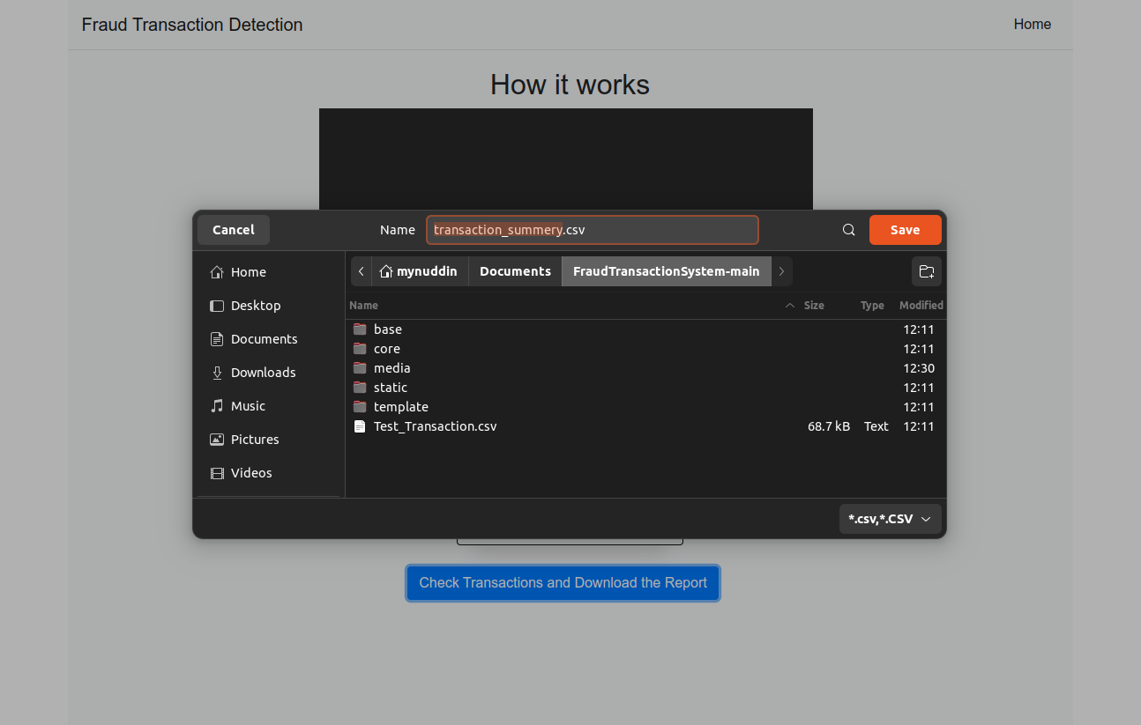
Project Progress

Slide 16
Demo project approach
Raw Data
RF = 98%
XGBoost = 98.58%
LGBM = 99%
Feature Engineering
Random Under Sampling
So, I integrate LGBM model in my demo project.
Apply ML algorithm
And get best 3

Slide 17
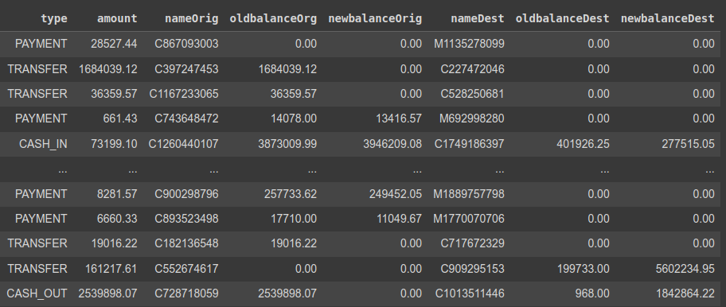
Sample Transaction

Slide 18
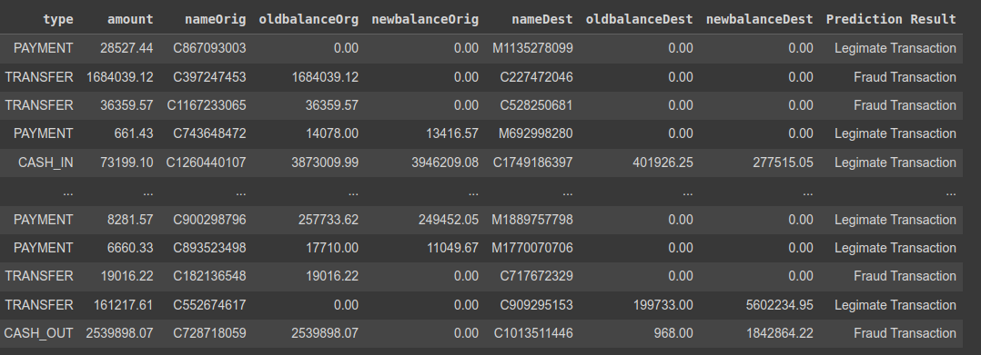
Transaction Report

Slide 19
Thanks To All 🙂

